Slide 1
Capstone Presentation
Siddharth tapre

Slide 2
Business Problem Understanding
Adaption of new advertising platform i.e. social media.
The behaviour of customers varies by device of use(laptop or mobile).
As costs are very high of advertising the model must be very effective.
Separate models must be built based on device.

Slide 3
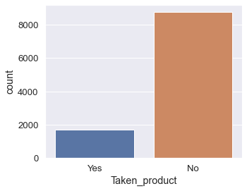
Insights from Analysis
We have converted all the columns into categorical type in order to build good models.
We can determine that the best no. of clusters is 2.
The target variable is not distributed equally but is random.

Slide 4
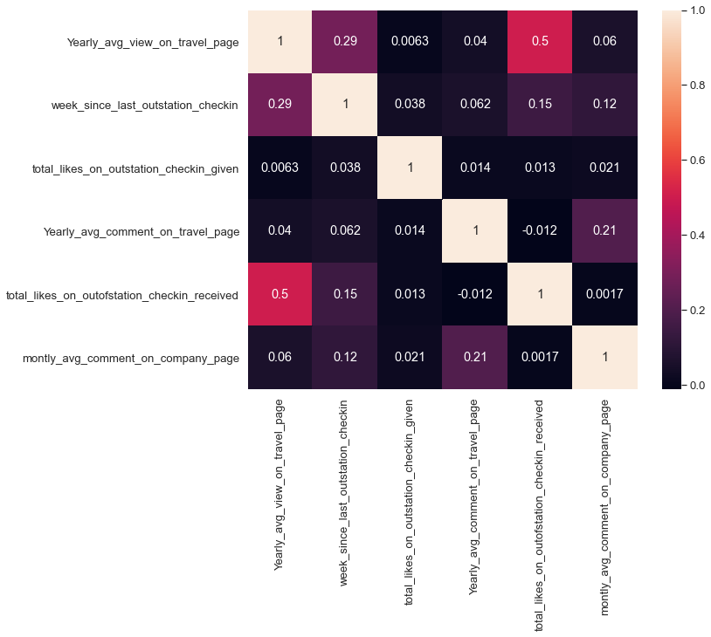
Insights from Analysis
Based on heatmap we can determine that there is very low correlation between various variables.
We can also determine that the data Is randomly split between devices used and target variable(taken product)

Slide 5
Modelling Approach Used & Why
We have built and tested various models which include decision tree, ANN,Logistic regression, LDA
Decision tree is the most fitting type of model for both the device types.
As both types of error are important considering the cost of advertising we will consider accuracy as the best matric to evaluate the model.
Score for laptop is 0.95 for test with 1.0 for train
Score for mobile is 0.96 for test with 1.0 for train

Slide 6
Modelling Approach Used & Why
As the decision tree model was an overfitting we are going to use various techniques to import the model.
We tried Random forest, ensambling.
Random forest have the best results
Accuracy for laptop model is 0.97
Accuracy for mobile model is 0.96
We can also determine that the most important variables for laptop data is ‘yearly avg outstation checkins’.
We can also determine that the most important variables for mobile data is also ‘yearly avg outstation checkins’.

Slide 7
Recommendations
As decision tree is a very well fitting model after categorising. And thus can say that variable affect the target variable directly.
The most important variable is ‘yearly avg outstation checkins’.
Variables such as likes, working, use of social media do not affect the target variable a lot.

